Slide 1
Computer Vision
Fall 2017 16720
Instructor: S. Narasimhan, D. Held
DH 2315
M-W 4:30pm – 5:50pm

Slide 2
Geometry of Multiple Views:
2- and 3-View Geometry

Slide 3
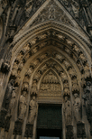
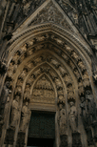
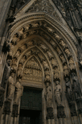
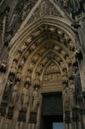
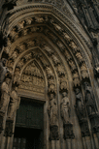
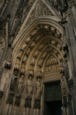
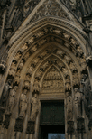
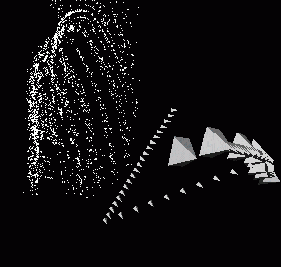

Slide 4
Three questions:
Correspondence geometry: Given an image point x in the first view, how does this constrain the position of the corresponding point x’ in the second image?
(ii) Camera geometry (motion): Given a set of corresponding image points {x_{i} ↔x’_{i}}, i=1,…,n, what are the cameras P and P’ for the two views?
(iii) Scene geometry (structure): Given corresponding image points x_{i} ↔x’_{i} and cameras P, P’, what is the position of (their pre-image) X in space?

Slide 5
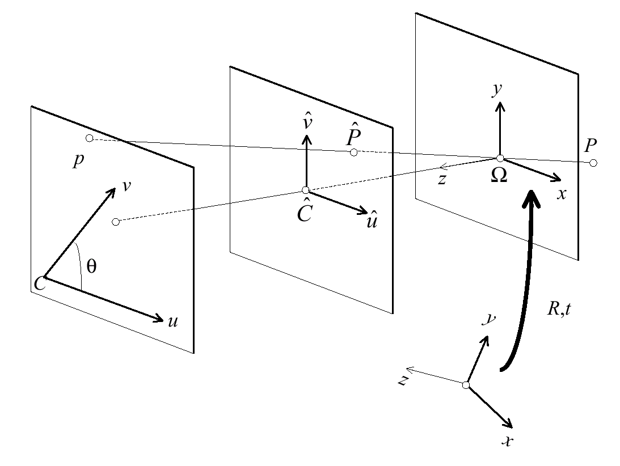
f
1
P
p

Slide 6
f
1
P
p

Slide 7
2-Camera Geometry
P
p’
p
t
O
R
O’

Slide 8
Epipolar Constraint
Given the projection of P in one image, its projection in the other image is constrained to be on a line, the epipolar line assciated with p
P
p

Slide 9
Epipolar Constraints
P
p
Epipolar
line
p’
Epipolar plane
O
O’

Slide 10
The epipolar lines are the intersection of the image planes with the epipolar planes

Slide 11
Epipoles are at the intersection of the epipolar lines
e’
O’
e
O

Slide 12
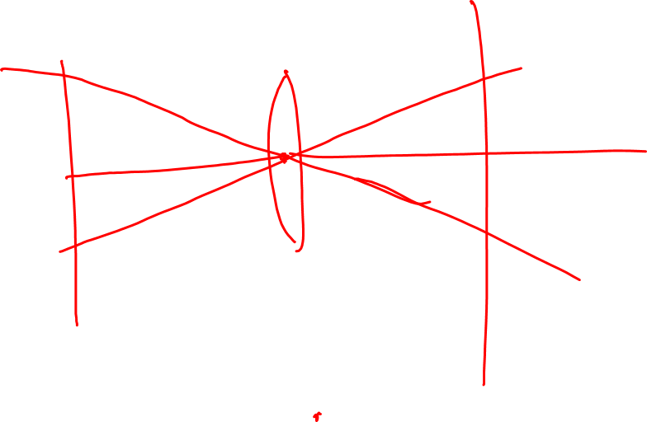

Slide 13
Special case: frontoparallel cameras. Epipoles are at infinity.
O
O’

Slide 14
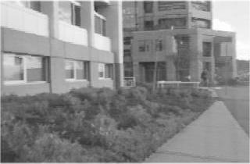
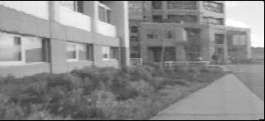
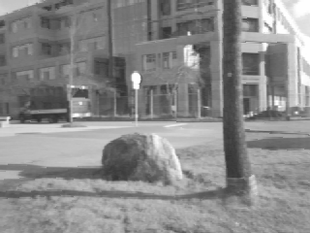
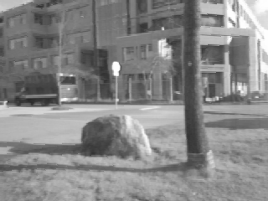
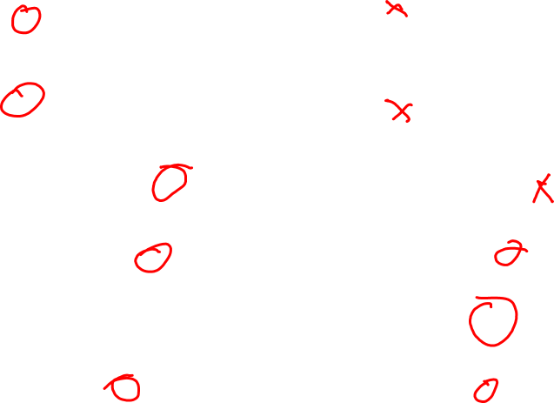
Epipolar Geometry Example

Slide 15
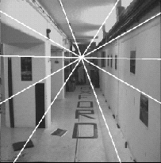
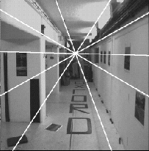
Forward Camera Motion
e’
e

Slide 16
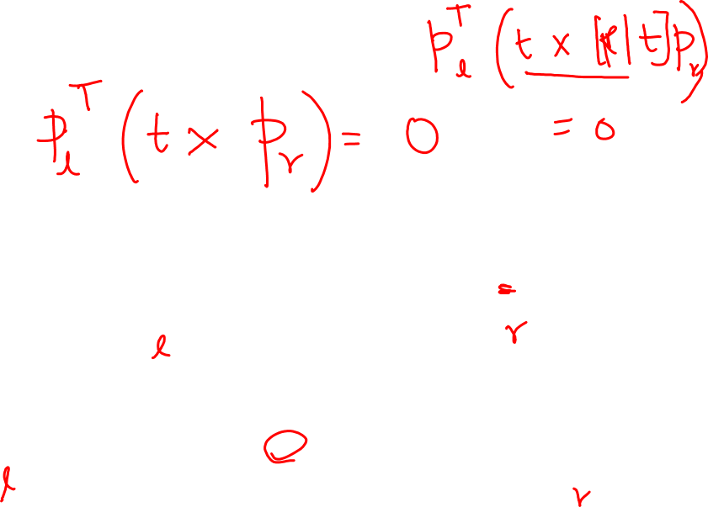
P
t
O
R
O’

Slide 17
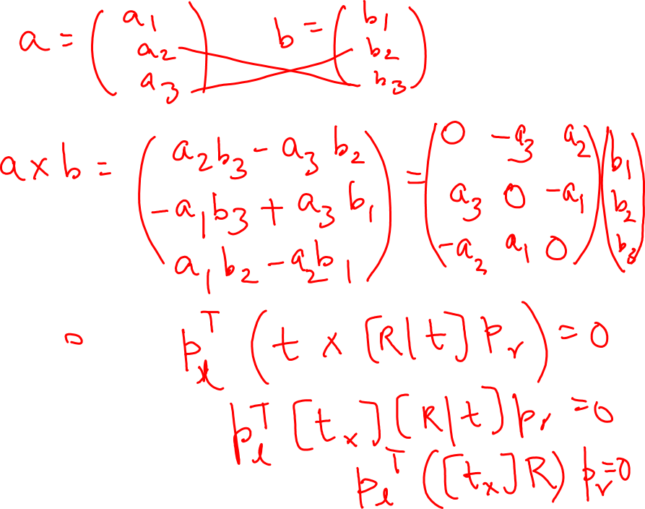

Slide 18
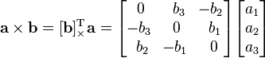
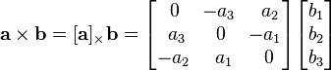
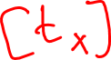
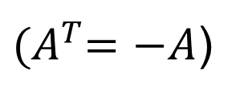
Cross Product in terms of matrix multiplication
Skew symmetric matrix
${(A}^{T}=−A$)
Determinant of odd skew symmetric matrix = 0
Eigenvalues come in pairs and a Zero eigenvalue.

Slide 19
In Normalized coordinates:
P
Essential Matrix
W
W’
t
O
R
O’

Slide 20
Properties of the Essential Matrix
Q: Can any 3x3 matrix E be an essential matrix?
A: No.
E must be singular → One singular value is 0
The 2 non-zero singular values of E must be equal
Q: Given 2 images, is E unique?
A: Almost. It is unique up to easy-to-deal with symmetries

Slide 21
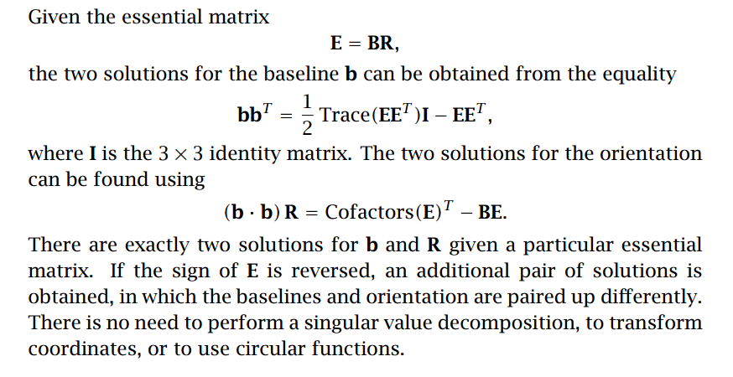
Decomposition of Essential Matrix
Horn 1990

Slide 22
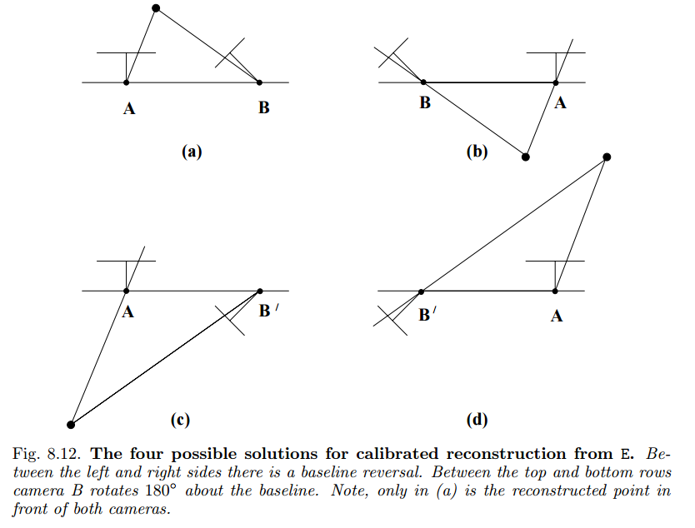
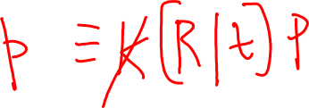
Decomposition of Essential Matrix

Slide 23
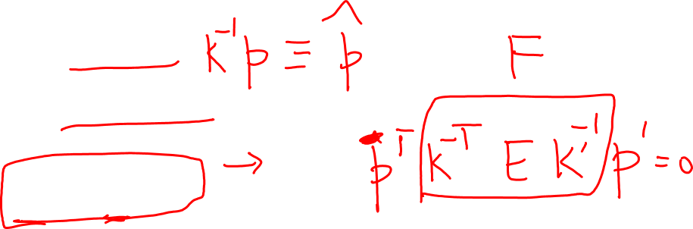
General Case: Write down conversion from normalized to real image coordinates
P
and substitute in
O
O’

Slide 24
General Case:
Fundamental Matrix
Relation between Fundamental and Essential Matrices
P
The epipole is the null space of F
t
O
R
O’

Slide 25
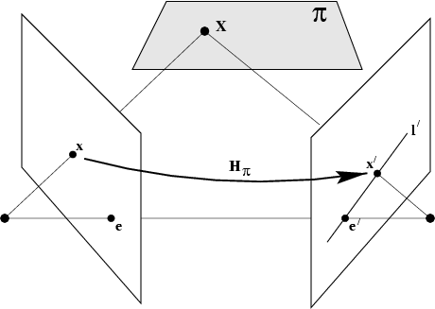
The fundamental matrix F
Another geometric derivation
Correspondence:
The fundamental matrix satisfies
the condition that for any pair
of corresponding points x↔x’
in the two images

Slide 26
Properties of the fundamental matrix F
Q: Can any matrix F be a fundamental matrix
A: No, F must be singular (rank = 2)
Q: Given 2 images, is F unique?
A: Absolutely not.
Transpose: if F is fundamental matrix for (P,P’), then F^{T} is fundamental matrix for (P’,P)
Epipolar lines: l’=Fx & l=F^{T}x’
Epipoles: on all epipolar lines, thus e’^{T}Fx=0, ∀x ⇒e’^{T}F=0, similarly Fe=0
F has 7 d.o.f. , i.e. 3x3-1(homogeneous)-1(rank2)
F is a correlation, projective mapping from a point x to a line l’=Fx (not a proper correlation, i.e. not invertible)

Slide 27
Estimating F from correspondences
Given: set of correspondences (p_{j}, p’_{j})
P_{j}
p_{j}
F has 7 free parameters → Minimum of 7 correspondences
F can be computed directly from 7 correspondences
p’_{j}
O
O’

Slide 28
Estimating F from 8 correspondences:

Slide 29
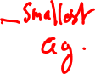
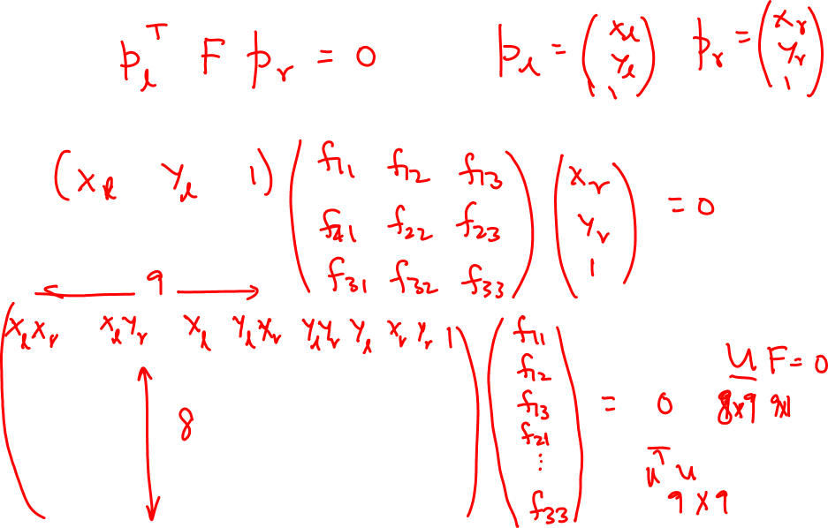
Estimating F from 8 correspondences:

Slide 30
Estimating F from 8 correspondences:
Uf = 0
U is a 8x9 matrix

Slide 31
For every correspondence:
Minimize over all correspondences:
Equivalent to:
Find min eigenvalue of 9x9 matrix:
P_{j}
Minimum
8 correspondences
“8-point algorithm”
p_{j}
p’_{j}
O
O’

Slide 32
The NOT normalized 8-point algorithm
~10000
~10000
~100
~10000
~10000
~100
~100
~100
1
!
Orders of magnitude difference
Between column of data matrix
→ least-squares yields poor results

Slide 33
The normalized 8-point algorithm
Transform image to ~[-1,1]x[-1,1]
(0,500)
(700,500)
(-1,1)
(1,1)
(0,0)
(0,0)
(700,0)
(-1,-1)
(1,-1)
Least squares yields good results (Hartley, PAMI´97)

Slide 34
Line described by vector of parameters: Fp’
p
Geometric distance between point and epipolar line:

Slide 35
Compute U from the correspondences
Compute the eigenvector of U^{T}U corresponding to the smallest eigenvalue
Make the resulting matrix F singular
Minimize the geometric error

Slide 36
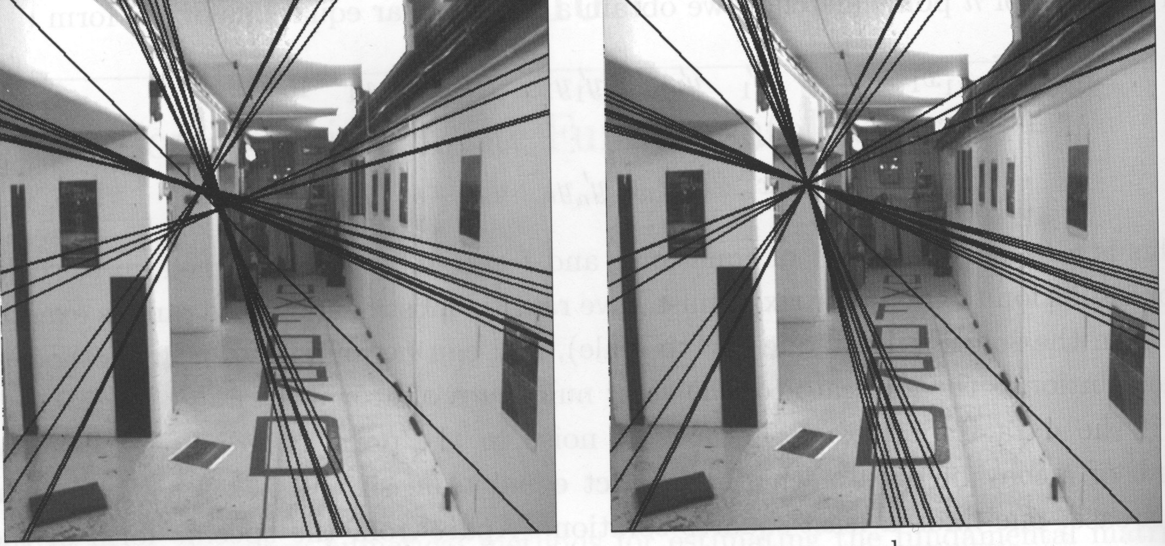
The importance of enforcing the constraint that F must be singular:
Incorrect F (non-singular matrix):
The epipolar lines do
not intersect
Correct F: All the epipolar lines
Intersect at the epipole

Slide 37
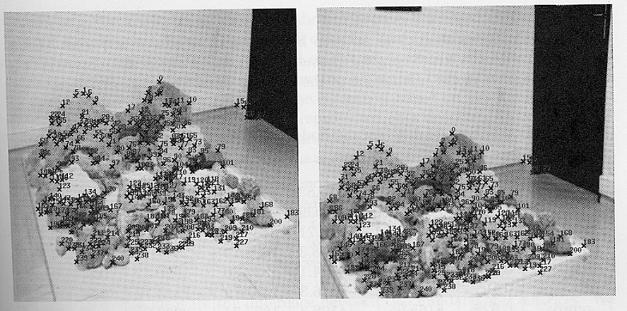

Slide 38
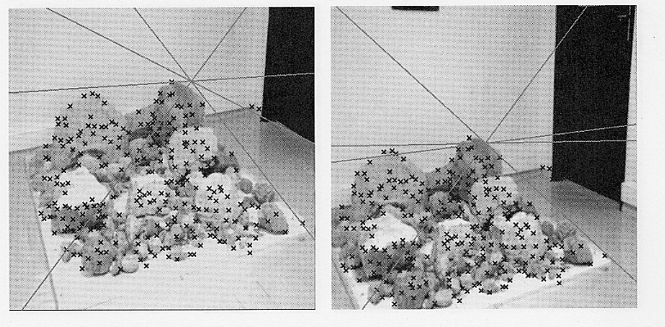
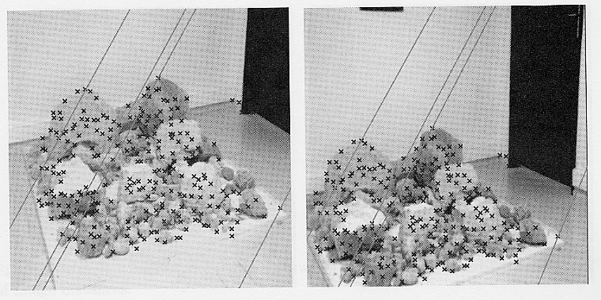
NO Normalization
WITH Normalization
The minimization is numerically unstable → Normalize the coordinates to magnitude between 0 and 1

Slide 39
Estimating from 7 correspondences:
Uf = 0
U is a 7x9 matrix
Two solutions: f₁,f₂ → F₁,F₂
General solution of the form: F = (1-λ)F₁+λF₂
Constraint: Det(F) = 0 → 3rd order polynomial in λ has at least one real solution

Slide 40
The algorithms so far assume that we know the correspondences between the images
In general, we do not know the correspondences and we must find them automatically
Solution: RANSAC = RANdom SAmple Consensus

Slide 41
RANSAC
Do k times:
Draw set with minimum number of correspondences
Fit F to the set
Count the number d of correspondences that are closer than t to the fitted epipolar lines
If d > d_{min}, recompute fit error using all the correspondences
Return best fit found

Slide 42
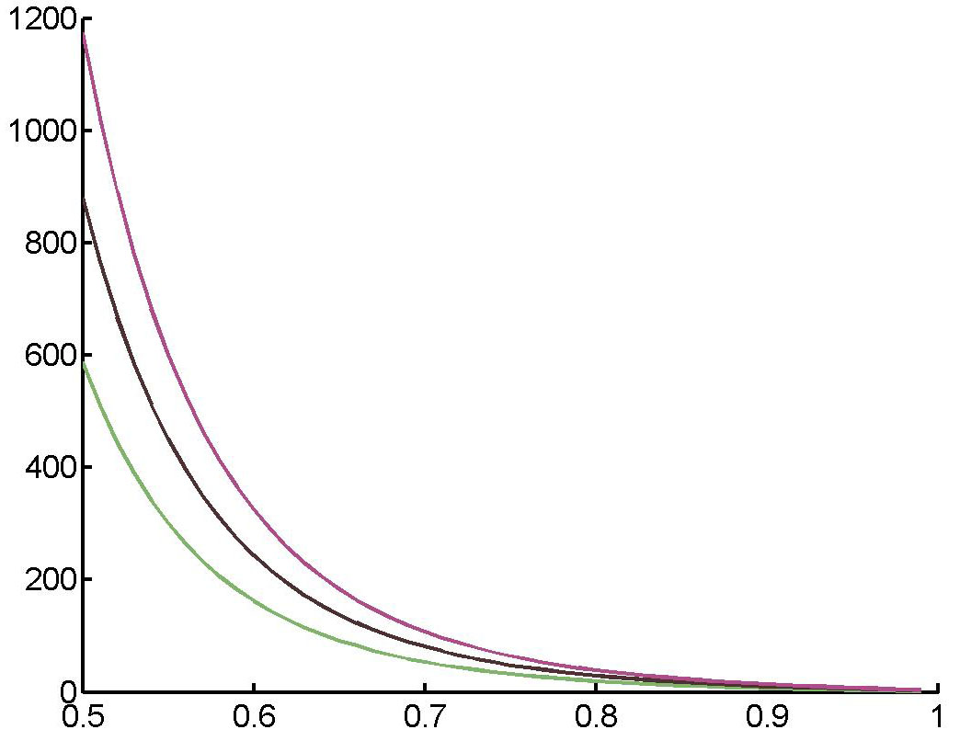
n = 7
ε = 10⁻⁴, 10⁻³, 10⁻²
ε = probability that no “good” set of correspondences will be found after t trials
t = number of trials necessary to achieve failure probability ε
n = Number of correspondences drawn in each trial
r = percentage of inliers (100% = all the correspondences are right)

Slide 43
Estimating F from exactly 7 correspondences
For RANSAC to work, it is best to use the minimum number of correspondences (7)
For 7 correspondences, U is 7x9 thus the solution of Uf = 0 is a 2-dimensional space
A generic solution is of the form:
F = α F₁ + (1-α) F₂
F₁ and F₂ are the matrices corresponding to 2 solutions f₁ and f₂ of Uf = 0 (null space of U)
Pick α to enforce:
Det(F) = Det(α F₁ + (1-α) F₂) = 0

Slide 44
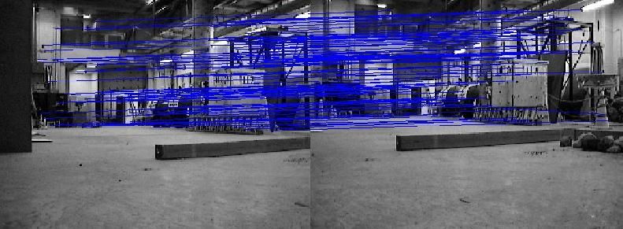
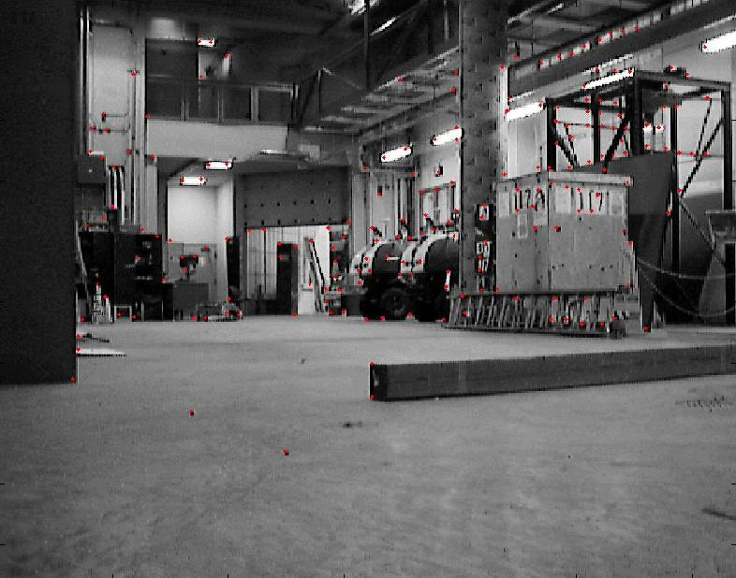
Initial Matches
Features from one Image

Slide 45
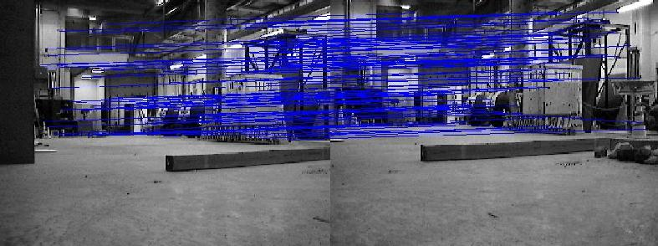
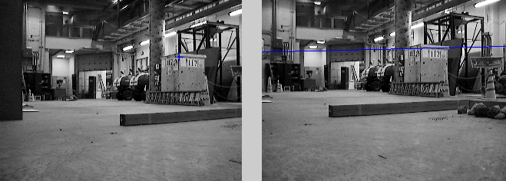
Filtered Correspondences
Epipolar Geometry

Slide 46
p₃
O₃
P
?
p₁
O₁
O₂

Slide 47
3-Camera Geometry: Epipolar Geometry
p₃
O₃
P
p₂
p₁
O₁
O₂

Slide 48
Trifocal Plane
O₃
O₁
O₂

Slide 49
3-Camera Geometry
L
l₃
Π₃
O₃
Π₁
Π₂
l₁
l₂
O₁
O₂

Slide 50
3-Camera Geometry
The fact that the projection of any point P on L in image i belongs to the line l_{i} can be written as:
L
l₃
Π₃
O₃
Π₁
Π₂
l₁
l₂
O₁
O₂

Slide 51
3-Camera Geometry
Since this is true for any point P on L, the matrix
must be of rank 2. This is expressed by an expression linear in l₁, l₂, l₃ → the trilinear (trifocal) tensor
L
l₃
Π₃
O₃
Π₁
Π₂
l₁
l₂
O₁
O₂

Slide 52
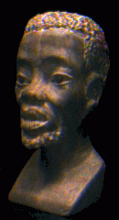
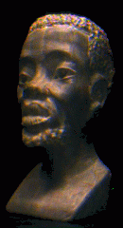
Example: View Transfer
p
p’
p’’
Given correspondence (p,p’), predict position of point p” in novel image
Example from A. Shashua, CVPR’97.

Slide 53



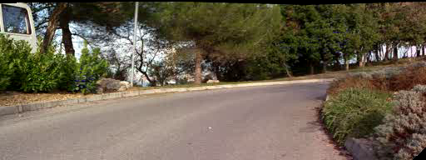
Mosaicing + View Interpolation (INRIA)
Example from Laveau
and Faugeras

Slide 54


Example:Feature Matching and Tracking
The image content at the location p” predicted by the trifocal tensor is consistent with the correspondence (p,p’) → The correspondence is correct
p’
p”
p
The image content at the location p” predicted by the trifocal tensor is not consistent with the correspondence (p,p’) → The correspondence is rejected

Slide 55
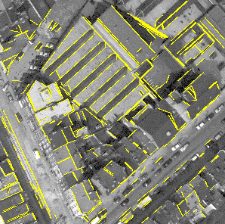
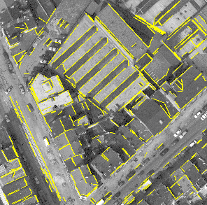
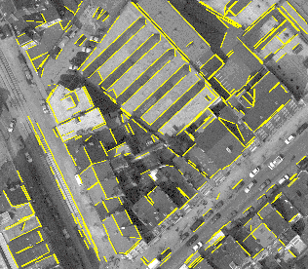
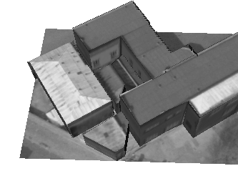
Example: 3D Reconstruction
Match lines across images
Use trifocal tensor for robust matching +
Recover geometry
Example from Schmid & Zisserman

Slide 56
Summary
Essential matrix
maps p’ to epipolar line Ep’
in normalized camera coordinates
3x3 matrix of rank 2
defined up to scale
the 2 non-zero singular values are
equal
5 parameters total
epipole is null space of E
Fundamental matrix
maps p’ to epipolar line Fp’
in image coordinates
3x3 matrix of rank 2
7 parameters total
epipole is null space of F

Slide 57
Fundamental Matrix and Weak Calibration
Linear: Basic 8-point algorithm:
minimize sum of square
algebraic errors.
Reduces to a min eigenvalue problem
Enforce the constraint of rank 2 by
setting smallest singular value to zero.
Non-linear: Minimize sum of
geometric errors.
Numerical issues: Rescale the
coordinates between –1 and 1 (approx.)

Slide 58
3-view geometry
Trifocal tensor relates projection
of a line in three images.
Defined by 26 parameters
= 3 3x3 matrices up to scale
2 independent relations
up to scale: 26 parameters – 8
constraints = 18 free parameters
Similar construction for points
instead of lines with 4 equations
Tensor estimation: Linear
if 2p+l >= 13
Trifocal tensor and fundamental
matrices enable view transfer

Slide 59
Forsyth & Ponce, Chapter 10
Szeliski, Chapter 7
Faugeras & Luong. The Geometry of Multiple Images.
MIT Press, 2001
Hartley & Zisserman. Multi View Geometry.
Cambridge Press, 2000

Slide 60
The classics:
Faugeras & Luong. The Geometry of Multiple Images. MIT Press, 2001
Hartley & Zisserman. Multi View Geometry. Cambridge Press, 2000
Xu & Zhang, Epipolar Geometry in Stereo, Motion, and Object Recognition, Kluwer Academic Publishers, 1996.
www.dai.ed.ac.uk/Cvonline
www-sop. inria.fr/robotvis/personnel/zzhang/CalibEnv/CalibEnv.html
www.cs.huji.ac.il/labs/vision/research/project.html#geometry
Longuet-Higgins, A computer algorithm for reconstructing a scene from 2 projections. Nature, 293, 1981.
Hartley, In defence of the 8-point algorithm, PAMI 19(6), 1997.
And, of course:
16-822, Geometry-based Methods in Vision

